Slide 1
FTP Access

Slide 2
Outline
- Bash FTP
- FileZilla
- FreeFileSync

Slide 3
Linux FTP Client
$ cd <destination path>
$ ftp -nvi 121.58.193.88
ftp> user <username>
Password: <Enter password>
ftp> cd <path>
ftp> get <filename> -OR- mget <filename pattern>
ftp> bye

Slide 4
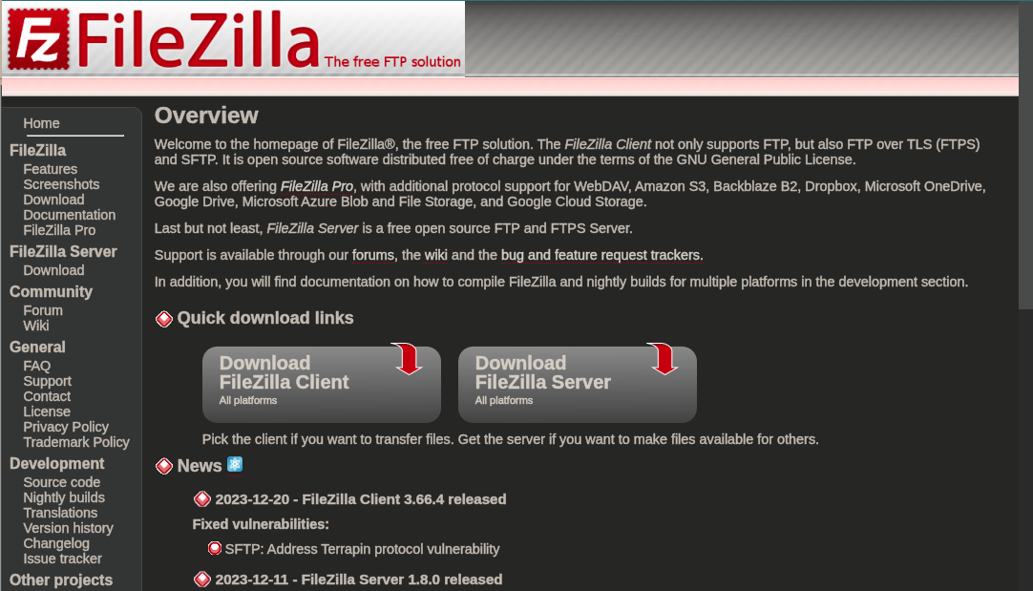
FileZilla
https://filezilla-project.org/

Slide 5
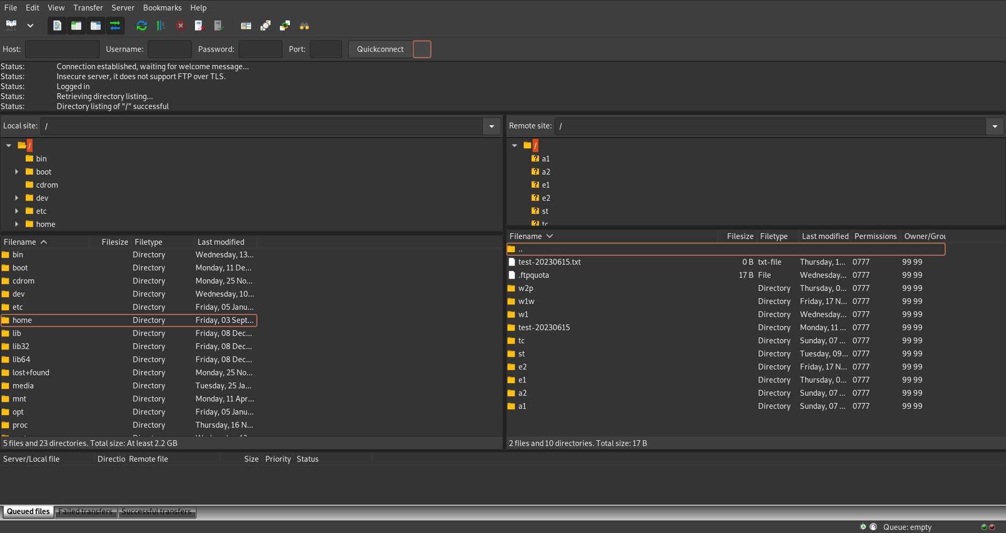
FileZilla

Slide 6
FileZilla
Fill up Host, Username, and Password (and Port: 21)

Slide 7
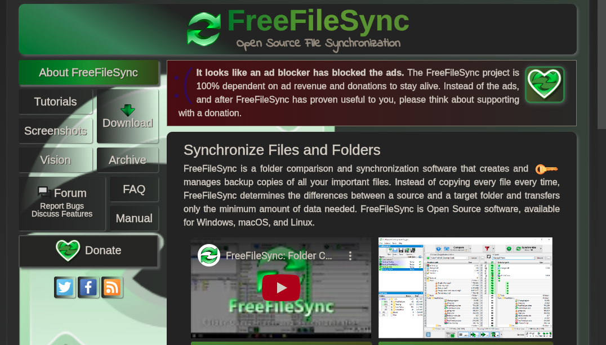
FreeFileSync
https://freefilesync.org/

Slide 8
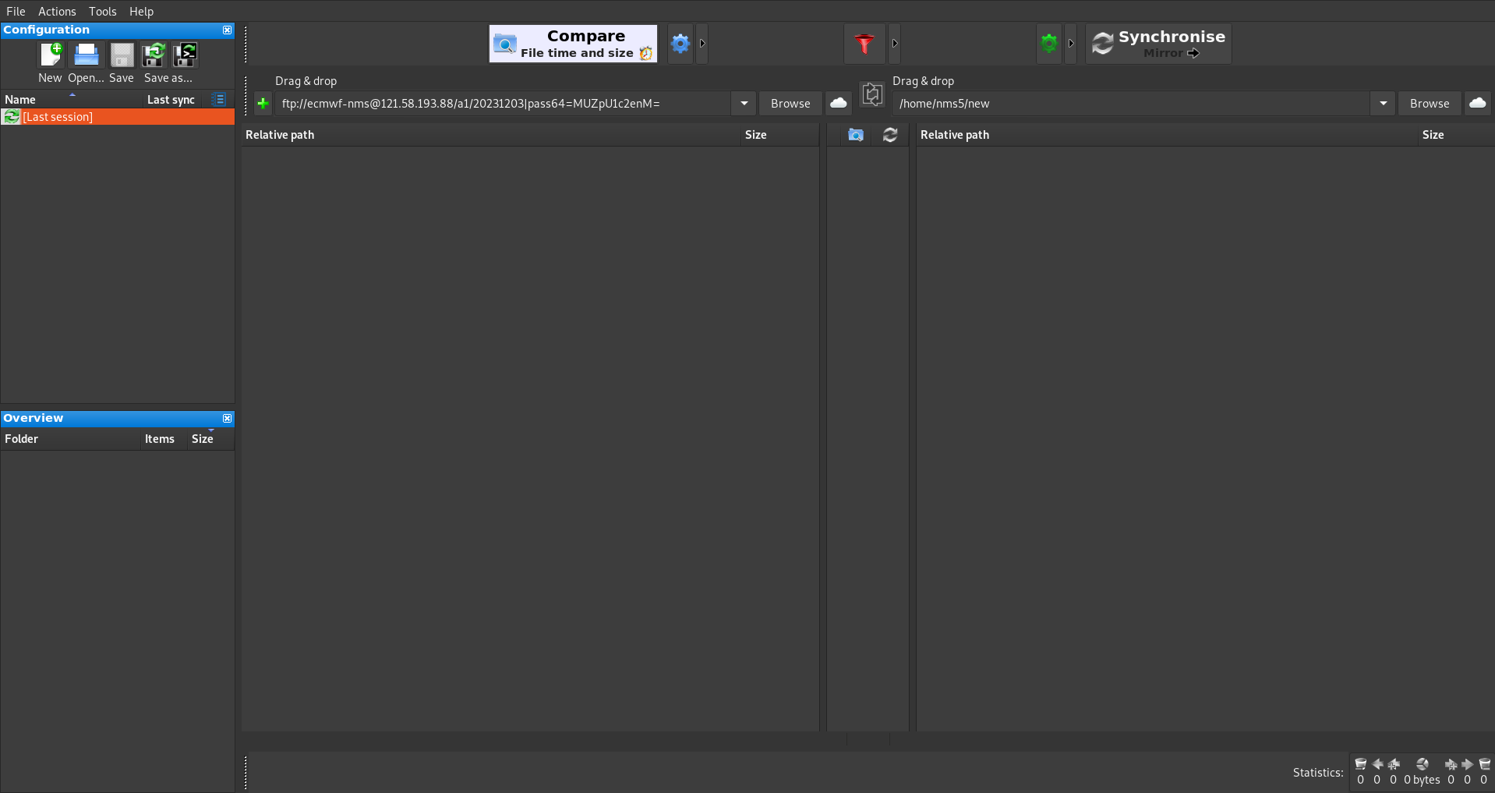
FreeFileSync

Slide 9
FreeFileSync
- Click the Cloud icon, click FTP, enter credentials and the desired source folder to sync.
- Click Browse to set destination folder
- Click the Arrow button near Synchronize, and choose Mirror
- Click Synchronize

